Slide 1
Lecture-2
Review of DSP Concepts

Slide 2
Advantages of DSP
Less sensitivity to Component Tolerance and Environmental Changes
Volume Production without the need for adjustment during construction or use
Amenable to full integration
Accuracy as word length cost also
Dynamic range with floating point arithmetic
Time sharing of a given processor
Easy adjustment of processor characteristics by changing coefficients(e.g Kalman filter)
Exact linear phase
Multirate processing
No loading problem due to cascading
Easy storage in tapes, disk

Slide 3
Disadvantages of DSP
Increased Complexity(S/H,A/D,D/A)
Frequency Range Limited due to S/H, A/D
F_{s}>=2f_{m}
F_{s} ➔resolution of A/D
Power Dissipation

Slide 4
Why DSP
Natural Choice if the signal is Digital
DSP, Even if the signal is analog?
Yes, In Many Cases
If so how is it done?

Slide 5
A DSP system
x(t)= A sin(2πft)
x(n)= A sin(2πnT)
{0,5,-1,10}
{2,5,10,100}
Analog
I/P
LPF
Anti-
Aliasing
filter
Sample
&
Hold
ADC
DSP
DAC
x(t)
x(nTs)
x(n)
y(n)
y(t)
Y’(t)
Sampling frequency(Fs)
Special purpose custom hardware
Digital signal processors(DSP’s)
General purpose processors

Slide 6

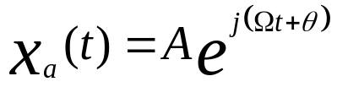
Concept of frequency in continuous-time and Discrete-time signal
Continuous sinusoidal Time Signal
For every fixed value of the frequency F x(t) is periodic
Continuous time sinusoidal signal with distinct frequencies are themselves distinct.
Increase the frequency result in increase in the rate of oscillation of the signal → more period are included.
Complex exponent from

Slide 7

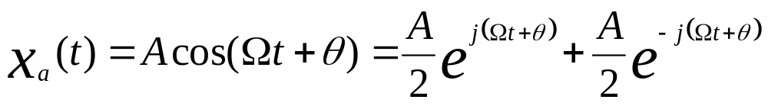
Phasor diagram
A/2
A/2

Slide 8

Sampling
Where x(n) is the discrete-time signal obtained by taking samples of the analog signal x_{a}(t) every T second. T=1/Fs where Fs is the sampling rate
Analog signal x_{a}(t)
x(n)
Fs=1/T
x_{a}(t)
x(n)
t
0
1
2
3
Sampling Theorem: if the highest frequency contained in an analog signal x(t) is F_{max}=B and the signal is sampled at rate Fs>2F_{max}=2B, then x(t) can be exactly recovered from its sample values using the interpolation function.
g(t)=sin2πBt/ 2πBt

Slide 9

Discrete time Sinusoidal
A discrete time signal is periodic if its frequency f is a rational number
Discrete time sinusoidal whose frequency are separated by an integer multiple of 2π are identical
The highest rate of oscillation in a discrete time sinusoidal is attained when w= π or(- π).

Slide 10
Discrete and Digital signal
Direct delta representation and unit sample representation
x(n)
Unit
sample
1
*
*
*
*
*
*
*
{1,0,0,0,…….}
0 1 2 3 4 5 6
x(n)
Unit
step
1
*
*
*
*
*
*
*
{1,1,1,1,…….}
0 1 2 3 4 5 6
Cosine
wave
x(n)
1
*
*
*
*
*
*
*
{1, cos(w₀T_{s}), cos(2w₀T_{s}),….}
x(n)={cos(w₀nT_{s})}
0 1 2 3 4 5 6

Slide 11
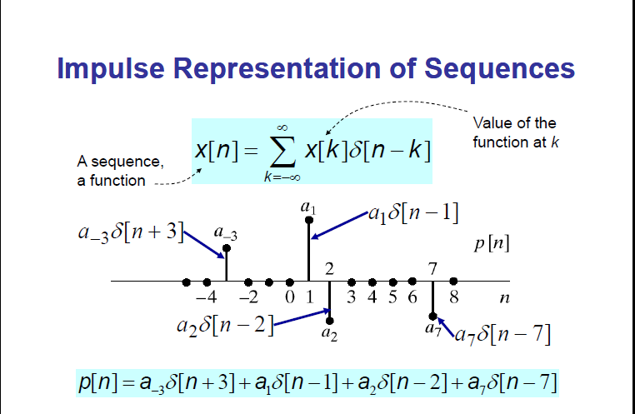

Slide 12
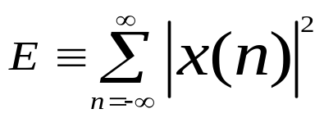
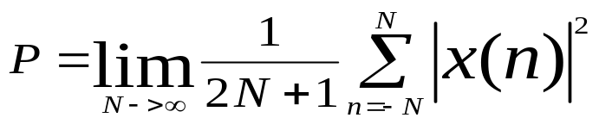
Classification of Discrete time signal
Energy signal and power signal: If E is the energy of a signal x(n)
If E is finite then x(n) is called an energy signal
Many signal possesss infinite energy, have a finite avarage power P. The avarage power define as:
If P is finite and nonzero then the signal is called a power signal
Periodic and aperiodic signal: a signal x(n) is periodic with period N if and only if x(n+N)=x(n) for all n
The smallest value of N for which holds the above equation is called fundamental period.
If there is no value of N that satisfies the above equation then the signal is called aperiodic signal.
Symmetric and antisymmetric signal: a real-valued signal x(n) is called symmetric if x(-n)=x(n)
On the other hand a signal x(n) is called antisymmetric if x(-n)=-x(n)

Slide 13
Discrete time system
Discrete time system is a device or algorithm that operate on a discrete time signal, called the input according to some well define rule, to produce another discrete time signal called output of the system.
y(n)=H(x(n))
Y(n)=0.8y(n-1)+0.5x(n)+0.9x(n-1)
Z⁻¹
y(n)
+
+
x(n)
Z⁻¹

Slide 14
Classification of discrete system
Static and Dynamic system:
A discrete time system is called static or memoryless it its output at any instant n depends at most on the input sample at the same time, but not on past or future samples of the input. In any other case the system is said to be dynamic or to have memory.
Time inveriant and time variant system:
A system is called time invariant if its input-output characteristics do not change with time.
A relaxed system H is time invariant or shift invariant if and only if
x(n) y(n) implies that x(n-k) y(n-k)
If the output y(n-k) not = y(n-k) even for one value of k the system is time variant
H
H

Slide 15

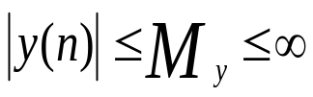
Linear and non-linear system: A linear system is one that satisfies the superposition principle. The principle of superposition requires that the response of the system to a weighted sum of signal is equal to the corresponding weighted sum of the response of the system to each of the individual input signal.
a system H is linear if and only if
H[a₁x₁(n)+a₂x₂(n)]=a₁H[x₁(n)]+a₂H[x₂(n)]
Causal and noncausal system: A system is said to be causal if the output of the system at any time n depends only on present and past input, but not depend on future inputs.
Y(n)=F[x(n),x(n-1),x(n-2)……….x(n-k)] where F is any function
If a system doesnot satisfy the above condition then the system is called noncausal system.
Stable and unstable system: An arbitray relaxed system is said to be bounded input-bounded output(BIBO) stable if and if every bounded input produces a bounded output. x(n), y(n) are bounded is simply translated mathematically to mean that there exist some finite numbers say M_{x}, M_{y} such that
for all n

Slide 16
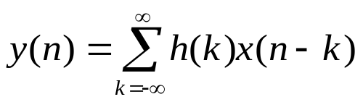
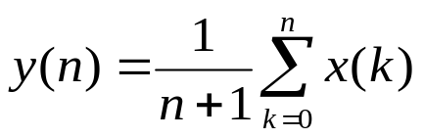
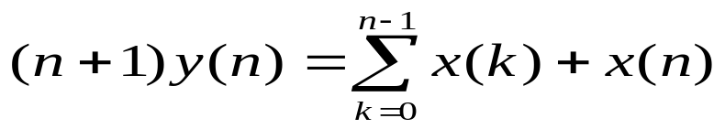

Recursive and Non-recursive discrete system.
Cumuativeaverage of signal x(n)
y(n)
x(n)
+
x
1/n+1
x
z⁻¹
n
A system whose output y(n) at time n depends on any number of past output values y(n-1), y(n-2) …. Is called recursive system

Slide 17
Lecture-3

Slide 18
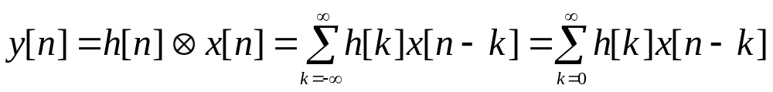
Convolution
Convolution is one of the most frequently used operations in DSP. Specially in digital filtering applications where two finite and causal sequences x[n] and h[n] of lengths N₁ and N₂ are convolved

Slide 19
Operations involved
Folding
Shifting
Multiplication
Summation
Signal Processing
ES & BM

Slide 20
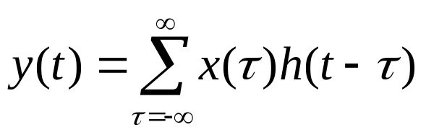
h(τ)
τ
x(τ)
τ
y(t)
t

Slide 21
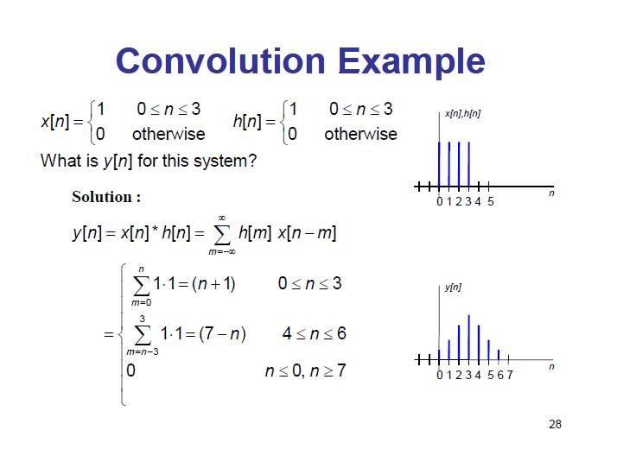
h(-τ)
τ
x(τ)
τ
y(t)
t

Slide 22
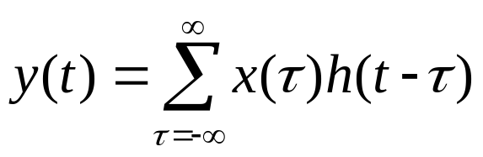
h(t-τ), t=0
τ
x(τ)
τ
y(t)
t

Slide 23
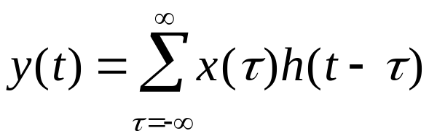
h(t-τ), t=1
τ
x(τ)
τ
y(t)
t

Slide 24
h(t-τ),t=2
τ
x(τ)
τ
y(t)
t

Slide 25
h(t-τ),t=5
τ
x(τ)
τ
y(t)
t

Slide 26
h(t-τ),t=5
τ
x(τ)
τ
y(t)
t

Slide 27
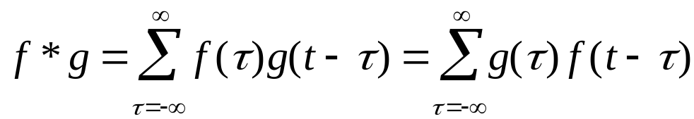
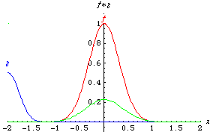
Example convolutions
The sum of the product of 2 functions after 1 is reversed & shifted.
Convolution of two Gaussians

Slide 29
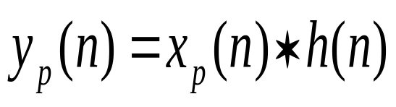
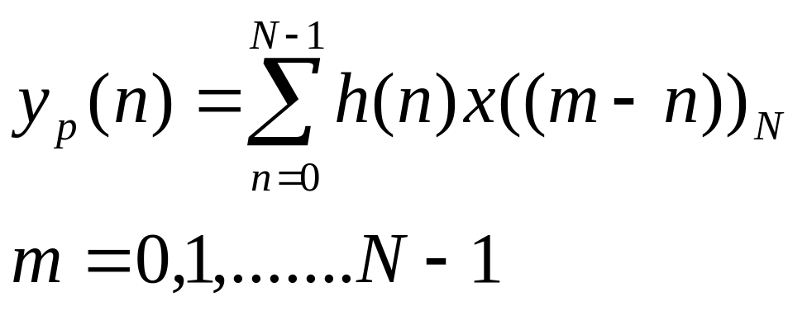
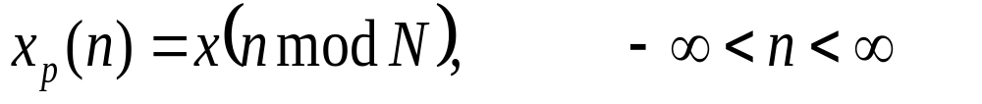
Circular convolution
Circular convolution of x(n) and h(n) is defined as the convolution of h(n) with a periodic signal xp(n) :
where

Slide 30
Correlation
Correlation is a mathematical operation that is very similar to convolution. Just as with convolution, correlation uses two signals to produce a third signal. This third signal is called the cross-correlation of the two input signals. If a signal is correlated with itself, the resulting signal is instead called the autocorrelation.

Slide 31
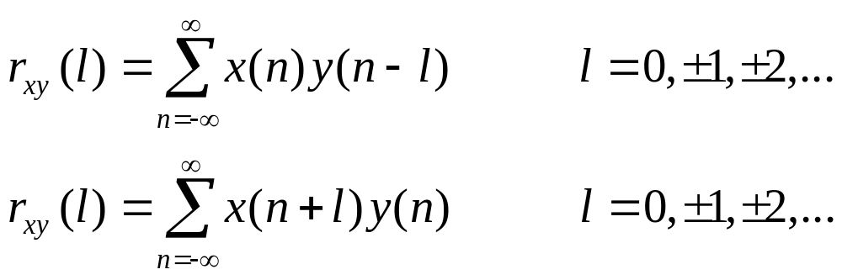
Correlation
Where, r_{xy}(l) is the correlation coefficients

Slide 32
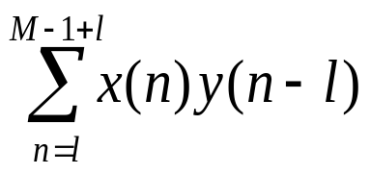

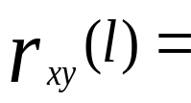
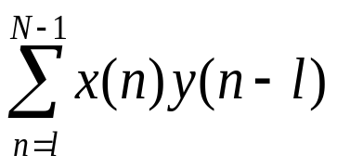

Computation of correlation
FOR l=1 to lmax
{
NL=M+1-l
IF(NL>N-1) NL=NL-1
R(L)=0.0
FOR(K=l TO NL
{
R(l)=R(l)+X(K)*Y(K-l)
}
}

Slide 33
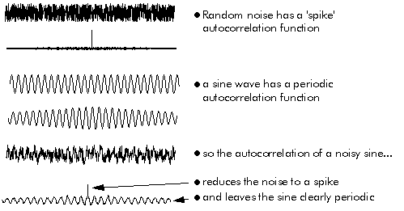
Autocorrelation can be used to extract a signal from noise

Slide 34
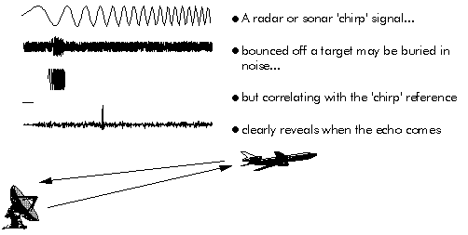
Cross correlation to locate signal
Cross correlation can be used to detect and locate known reference signal in noise

Slide 35
Convolution vs. correlation
Convolution is the relationship between a system's input signal, output signal, and impulse response.
Correlation is a way to detect a known waveform in a noisy background.
The similar mathematics is only a convenient coincidence.

Slide 36
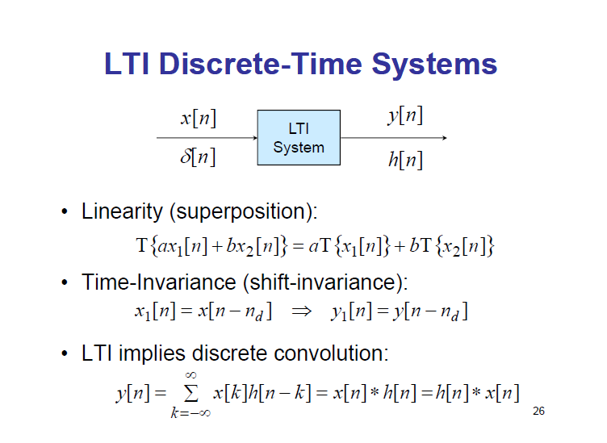

Slide 37
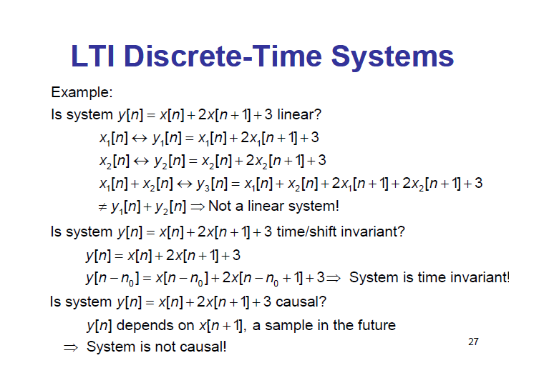

Slide 38
Z -TRANSFORM

Slide 39
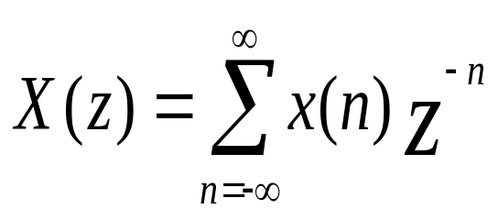
Denotated as
z
x(n)
X(n)
X(z)=Z{x(n)}
Z-transform is an infinite series, it exists only for those value of z for which this series converges. The Region Of Convergence(ROC) of X(z) is the set of all values of z for which X(z) attains a finite value.
x (n)={1,2,5,8,0,2}
X(z)=z²+2z¹+5+8z⁻¹+0z⁻²+2z⁻³
ROC entire z plane except z=0 and z=∞

Slide 40
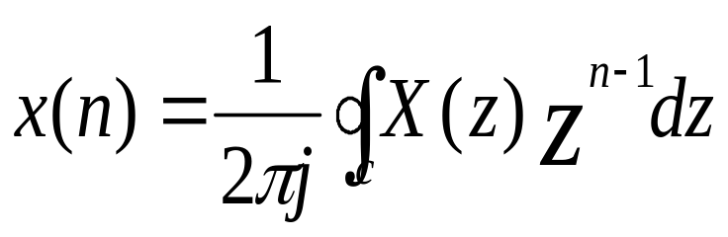
Invers z-transform
Where c denoted the closed contour in the ROC of X(z).

Slide 41
DISCRETE FOURIER TRANSFORM
(DFT)

Slide 42
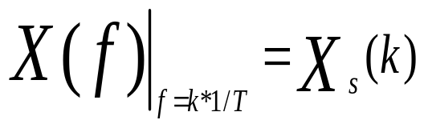
x(n) is the discrete signal FT is X_{s}(f)
x(n)
X(f)
Frequency domain sampling of the FT→DFT

Slide 43
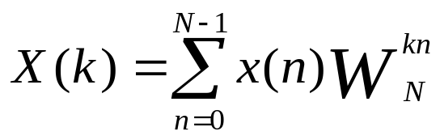
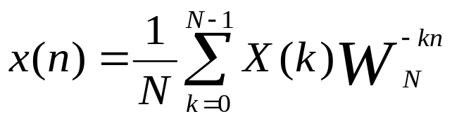

DFT
k=0,1,2,3…….N-1
IDFT
n=0,1,2,3…….N-1
Where W_{N} is define as
DFT is the set of N sample {X(k)} of the fourier transform X(w) for a finite –duration sequence {x(n)} of length L<=N. the sampaling of X(w) occure at the N equaly spaced frequencies w_{k}=2πk/N, k=0,1,2,3… N-1

Slide 44
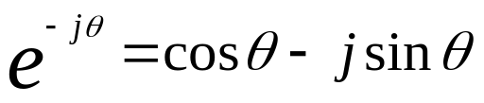
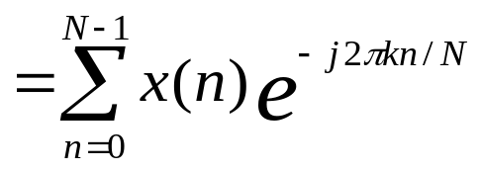
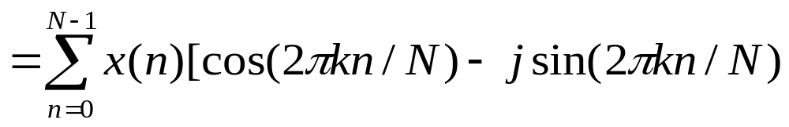
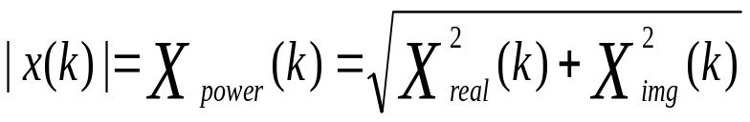
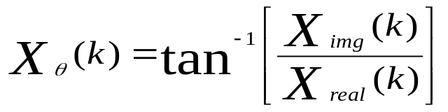
X(k)=X_{real}(k)+j X_{imag}(k)
f(k)=kf_{s}/N

Slide 45
Properties of DET
Periodisity: if x(n) and X(k) are an N-point DFT then
x(n+N)=x(n) for all n
X(k+N)=X(k) for all k
Linearity: if
DFT
DFT
x₁(n)
X₁(n)
x₂(n)
X₂(n)
N
N
DFT
a₁x₁(n)+a₂x₂(n)
a₁ X₁(n)+a₂ X₂(n)
N
Symmetry:

Slide 46
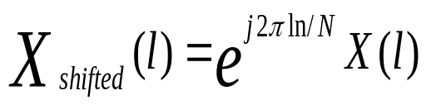
DFT Shifting theorem:
x(n) is shifted to the right by l sample
DFT Leakage:
DFT Resolution, Zero stuffing:
DFT Magnitudes:
When a real input signal contains a sine wave component of peak amplitude A₀ with an integral number of cycles over N input samples the output magnitude of the DFT for that particular sine wave is M_{r} where
M_{r}=A₀*N/2
If the DFT input is a complex sinusoid of magnitude A₀ with an integral number of cycles over N input samples the output magnitude of the DFT is M_{c} where
M_{c}=A₀N
DFT Processing Gain:

Slide 47

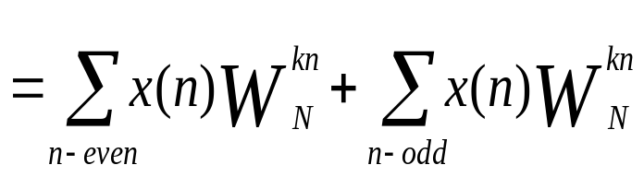
Fast Fourier Transform
let the computation of N=2^{v} point DFT , split the N point data sequence into two N/2 point data sequence f1(n),f2(n) corresponding the even-number and odd-numberd samples of x(n)
f1(n)=x(2n), f2(n)=x(2n+1)
Thus f1(n) and f2(n) are obtained by decimating x(n) by a factor of 2 and hence the resulting FFT algorithm is called Decimating in time algorithm:

Slide 48
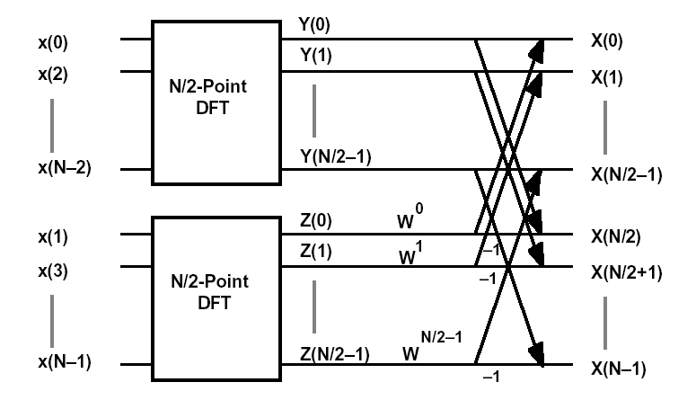

Slide 49
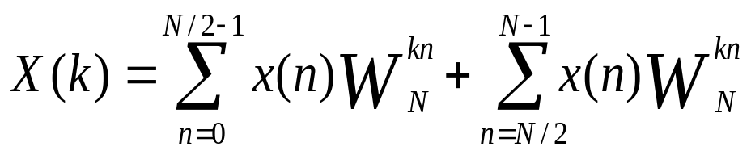
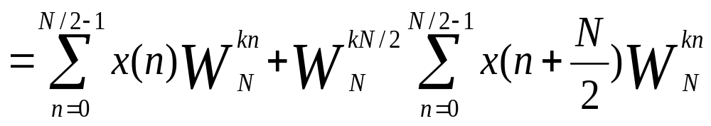
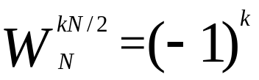
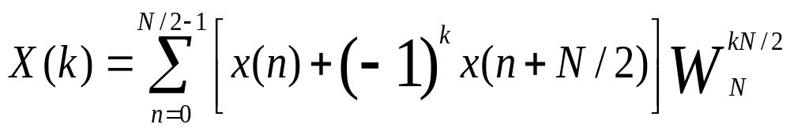
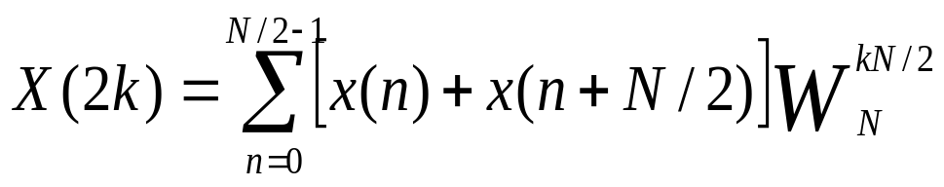
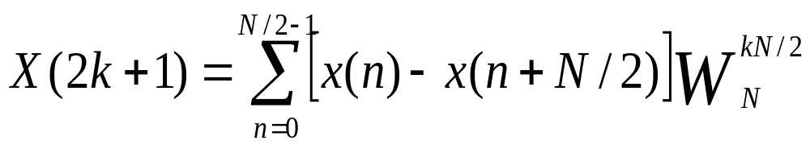
Decimation in Frequency
Now

Slide 50
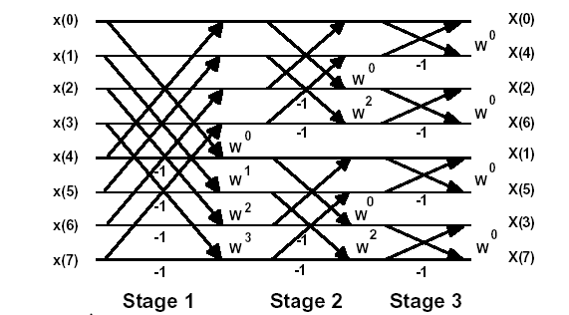

Slide 51
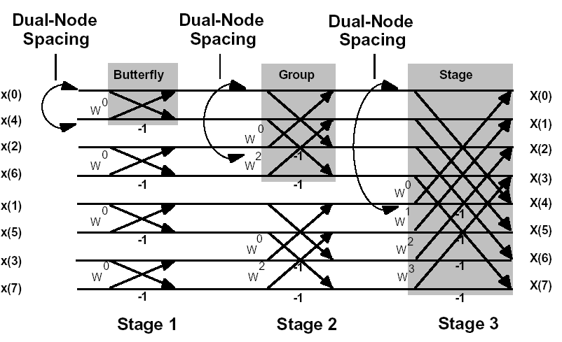

Slide 52
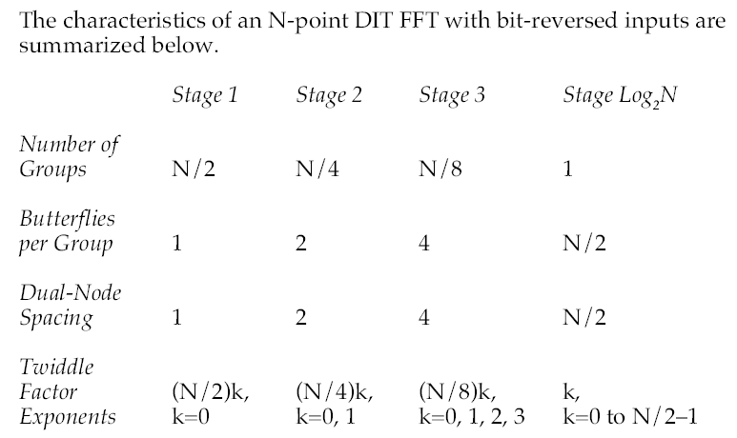
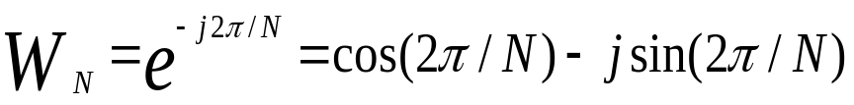
x0+jy0
x’0+jy’0
C+j(-S)
x1+jy1
x
x’1+jy’1
-1

Slide 53


Slide 54

x0+jy0
x’0+jy’0
C+j(-S)
x1+jy1
x’1+jy’1
-1
x

Slide 55
FIR Filter

Slide 56

A finite impulse response(FIR) filter is a discrete linear time-invariant system whose output is based on the weighted summation of a finite number of past input.

Slide 57

x(n)
z⁻¹
z⁻¹
z⁻¹
z⁻¹
h(0)
h(1)
h(2)
h(M-2)
h(M-1)
x
x
x
x
x
∑
y(n)

Slide 58
DFT
IDFT
x(n)
X
h(k)
Time
domain
Filter out put in time domain
y(n)=h(k)*x(n)
IDFT
DFT
DFT
DFT
Frequency
domain
Filter out put in frequency domain,
Y(m)=H(m).X(m)

Slide 59
Low-pass FIR filter design using Windows
H(f)
-fs
-fs/2
fs/2
fs
m=-N
m=-N/2
m=N/2
m=N/2
m=N
0 to fs

Slide 60


Algebraic determination of time-domain coefficients of low pass filter
Develop an expression for the discrete frequency response H(m)
Apply that expression to the inverse DFT equation to get the time domain h(k)
Evaluate that h(k) expression as a function of time
Let H_{d}(w) is the frequency response of a low-pass filter of time response h_{d}(n)
The unit sample response obtained from the above equation is infinite in duration and must be truncated at some point say n=M-1 for a FIR filter of length M this truncation is equivalent to multiplying h_{d}(n) by a window function w(n).
h(n)= h_{d}(n)w(n)

Slide 61





Window Function for FIR Filter Design
Name of Window | Window function
Bartlett(triangular)
Blackman
Hamming
Hanning
Kaiser

Slide 62







Example
Let the frequency response of a low-pass filter as
0
otherwise
A delay of (M-1)/2 unit is incorporated into H(w) in anticipation of forcing the filter to be of length M

Slide 63
Type of Window | Approximate Transition width of main Lobe | Peak Sidelobe
Rectangular | 4π/M | -13
Bartlett | 8π/M | -27
Hanning | 8π/M | -32
Hamming | 8π/M | -43
Blackman | 12π/M | -58

Slide 64

Band-pass FIR filter design:
High-pass FIR filter design:

